Slide 1


WELCOME TO PRESENTATION

Slide 2

Drone Base Intelligent
Magnetic Sensing System &
Metallic Anomaly Detection System
TEAM
GEO-EXPLORER PRESENTATION
KATHAN MASTER
PRAGATI MODHIYA
KARAN MISHRA
HIMANI VANDARA
DIVYA PRAJAPATI
NAVNEET CHAUHAN

Slide 3
PROBLEM OBJECTIVE
MAGNETIC FIELD DETECTION
OBJECT DETECTION
IDENTIFICATION & CLASSIFICATION
Design a compensation methodology to account for the drone's magnetic field, ensuring accurate measurements.
Utilize open-source geomagnetic anomalies data for a specific region to identify and classify metallic magnetic anomalies.
Develop a Drone-based Intelligent Magnetic Sensing System to assess magnetic fields in specific areas (land or sea)..
Develop a methodology for identifying unidentified metallic magnetic anomalies within the selected region.

Slide 4

TABLE OF CONTENTS
OUR PROPOSED SOLUTION
MAGNETIC FIELD DETECTION
OBJECT DETECTION
IDENTIFICATION AND CLASSIFICATION

Slide 5
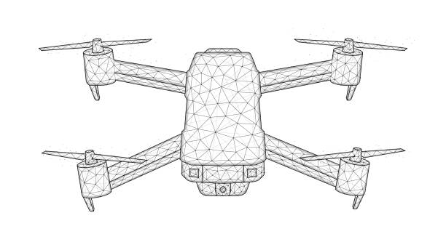
OUR PROPOSED SOLUTION
We aim to develop a Drone-based Intelligent Magnetic Sensing System, equipped with learning algorithms and magnetic compensation techniques, to detect, identify, and classify metallic objects using Earth's magnetic field anomalies.

Slide 6

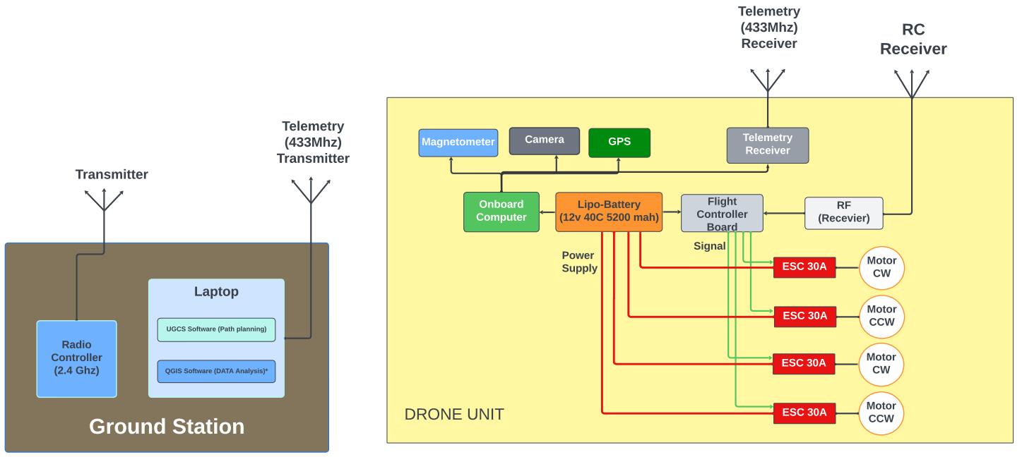
BASIC BLOCK DIAGRAM

Slide 7
MAGNETIC FIELD DETECTION

Slide 8

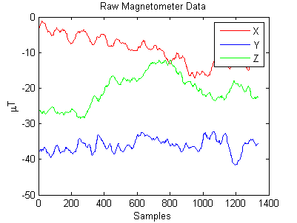
MAGNETIC FIELD DETECTION
Magnetic field detection will be accomplished by equipping the drone with a precision magnetometer, GPS, and Raspberry Pi for real-time data collection and processing. By continuously measuring and analyzing magnetic field data and utilizing established algorithms, we can identify magnetic anomalies and disturbances in a specific geographic region.

Slide 9
COMPONENTS IN DRONE
FLIGHT CONTROLLER To control drone motor with the help of receiver of Remote Controller. And for Autonomous Flight | GPS Precision navigation and location tracking. Covers up to 10 kilometers above the Earth's surface. | MAGNETOMETER Precision magnetic field intensity measurement. Fiend Magnetic Signature of an area
RASPBERRY PI ON BOARD COMPUTER Central control hub managing data acquisition, preprocessing, and telemetry | PI CAM Visual data capture for comprehensive analysis High-resolution imaging for detailed object recognition | TELEMETRY RADIO Vital communication link for real-time drone data transmission. Ensures data security through encryption protocols

Slide 10
OBJECT DETECTION

Slide 11
GPS & MAGNETOMETER SENSOR DATA
Introduction
Collecting GPS & Magnetometer DATA
DATA Integration
DATA transformation
.CSV Format
Benefits of .CSV Format
Data Analysis

Slide 12
TELEMETRY COMMUNICATION
SENDING
RECEIVER
ERROR HANDLING
This is the process where the drone transmits various data, including telemetry (like GPS coordinates, altitude, and speed), and magnetometer readings to the ground station. It's like the drone sharing its status and sensor information.
The receiver is the ground station or software that listens to the data sent by the drone. It collects this data from the drone's telemetry system and magnetometer. The receiver plays a crucial role in processing and making sense of the data.
Error handling is a safety net. Sometimes, during data transmission, errors or glitches can occur. Error handling mechanisms in the communication system ensure that if there are any problems or missing data in what the drone sends, they are identified and corrected or reported. This is vital for reliable and accurate data interpretation.

Slide 13
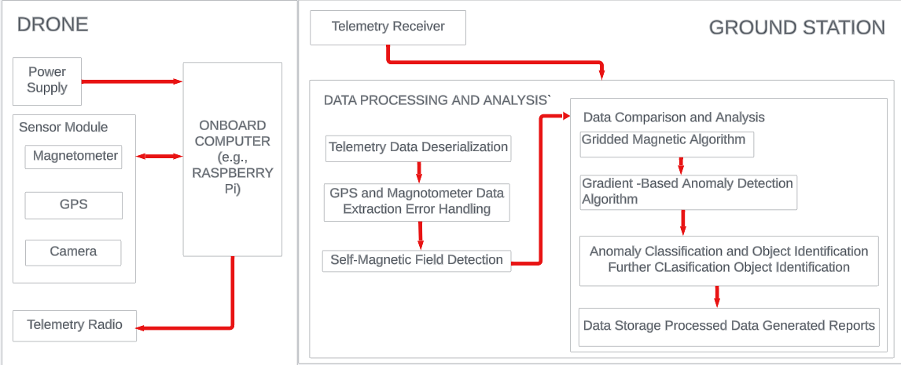
BASIC BLOCK DIAGRAM

Slide 14
GRIDDED MAGNETIC ALGORITHM
WHY THIS ?
Used to analyze magnetic field data from magnetometers.
Calculates expected magnetic field values at grid points, compares with measured data, and detects anomalies.
HOW THIS ?
Specialized software or custom algorithms.
ALTERNATE OPTION ?
Measured magnetic field (XYZ), grid parameters, Earth's magnetic model, thresholds. Anomaly map highlighting magnetic variations, anomaly details, for geophysics and exploration.
INPUT & OUTPUT

Slide 15
IDENTIFICATION & CLASSIFICATION USING ML

Slide 16
GRIDDED GRADIENT
Purpose: Identifying Anomaly
I/P:
Geospatial Data
GPS + Magnetometer
Parameter of grid size threshold value
O/P:
Anomaly map
Characteristic: Size, Intensity & Orientation.
Purpose: Classification
I/P:
Geospatial Data
GPS + Magnetometer
Parameter Gradient Calculating & threshold
O/P:
Anomalies: Size & Intention
Classification: Type & Score

Slide 17
PATH PLANNING : UGCS SOFTWARE
UGCS (Unmanned Ground Control Software) is a comprehensive and versatile software platform designed for the control and management of unmanned aerial vehicles (UAVs) or drones. It offers a wide range of features and capabilities that make it a valuable tool for drone operators and researchers.
Features:
Flight Planning
Real Time Monitoring
Mission Automation
Safety Features
User Friendly Interface
Commercial

Slide 18
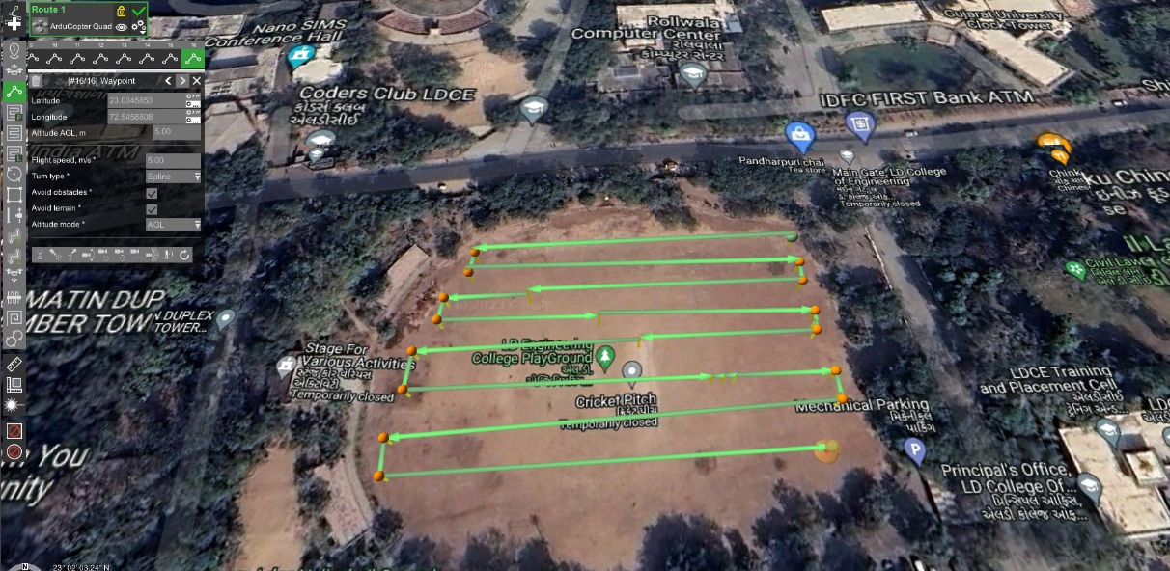
PATH PLANNING : UGCS SOFTWARE

Slide 19
GEO-MAPPING : QGIS SOFTWARE
QGIS is known for its versatility, ease of use, and extensive features, making it a popular choice in various fields that involve spatial data and mapping. QGIS is a widely-used open-source Geographic Information System (GIS) software. It is designed to help users create, edit, visualize, analyze, and manage geographical data and maps
Features:
Analysis tools
3D Map Creation
Open Source
Cross-Platform
User Friendly Interface
Data import & edieting

Slide 20
SELF-MAGNETIC FIELD
COMPENSATION

Slide 21
STEPS FOR SELF-MAGNETIC FIELD
COMPENSATION
Initialization
Data Acquisition Loop:
Orientation Estimation
Magnetic Field Model
Compensation Calculation
Combine Components
Data Logging/Usage

Slide 22
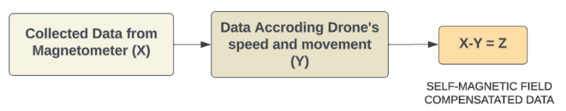
BLOCK DIAGRAM

Slide 23

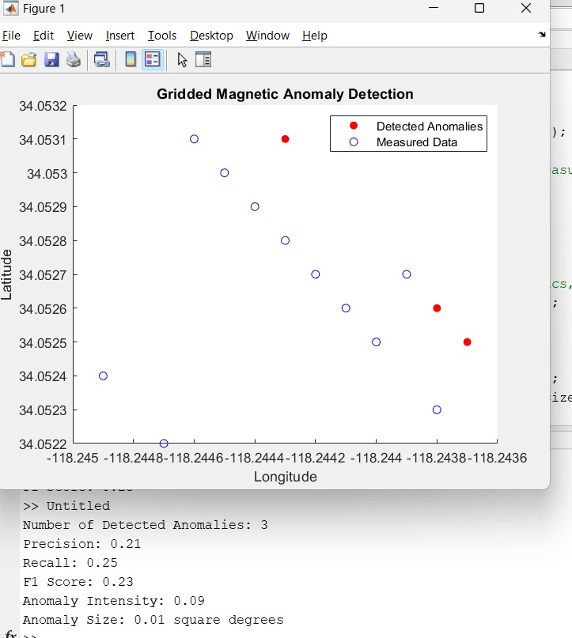
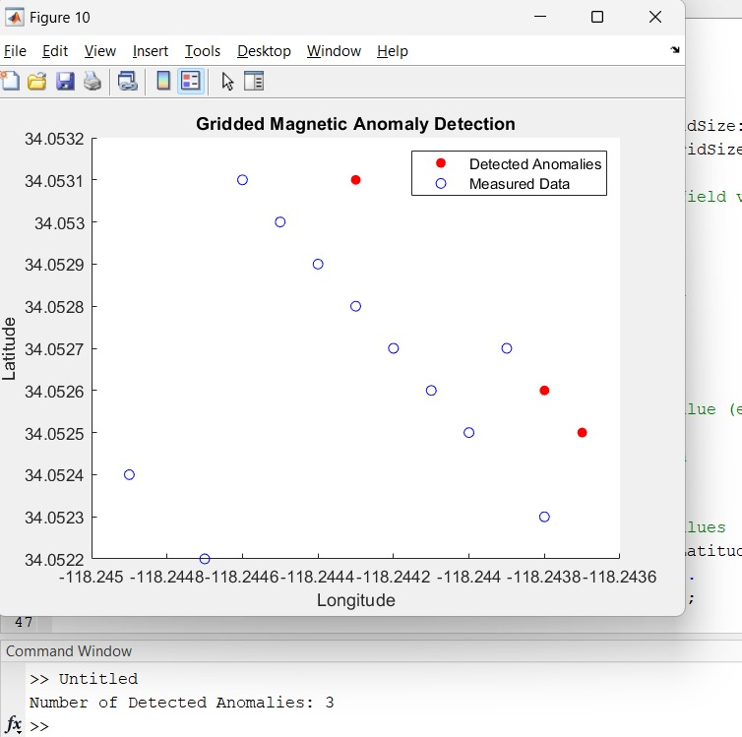
MATLAB SAMPLE DATA

Slide 24
THANK YOU!

